Slide 1
Introduction to Parallel Computing with OpenMP
Presented By
Kapil Sawate
TEJESH CHAURAGADE
HPC Tech CDAC(Pune)

Slide 2
Contents
OpenMP Basics
How threads interacts
Fork Join Parallelism
How a OpenMP interact with Lower Level Runtime.
Pi Program
Synchronization & Worksharing
Runtime Library Routines
Environment Variable

Slide 3
Introduction
OpenMP is one of the most common parallel programming models in use today.
It is relatively easy to use which makes a great language to start with when learning to write parallel software.

Slide 4

Basic Architecture
Processor
Processor
--------------------------
--------------------------
CORE
Memory
Older processor had only single CPU core to execute instructions
Memory
Processors have 4 or more independent CPU cores to execute instructions

Slide 5
Sequential Program Execution
Instruction
When you run sequential program
Instructions executed in serial
Other cores are idle
Waste of available resource… We want all cores to be used to execute program.
HOW ?
--------------------------
--------------------------
Memory

Slide 6
OpenMP : An API for writing Multithreaded Application
Set of compiler directives and library routines for parallel application programmers .
Greatly simplifies writing multi-threaded (MT) programs in Fortran, C and C++ .
Standardise last 20 years of SMP practice.

Slide 7


OpenMP Follows..
Explicit Parallelism
Shared Memory

Slide 8
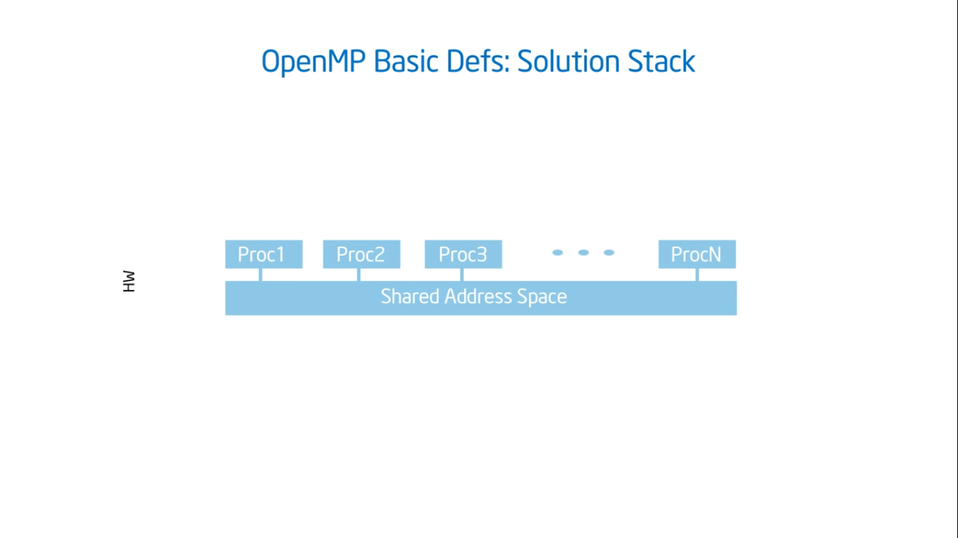

Slide 9
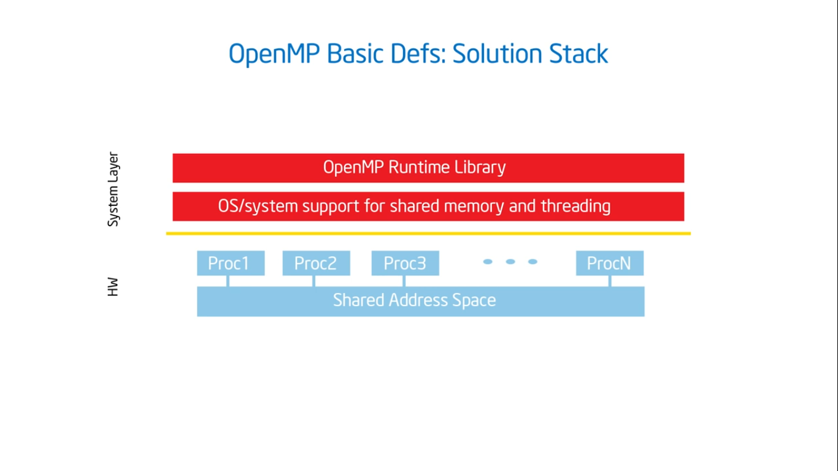

Slide 10
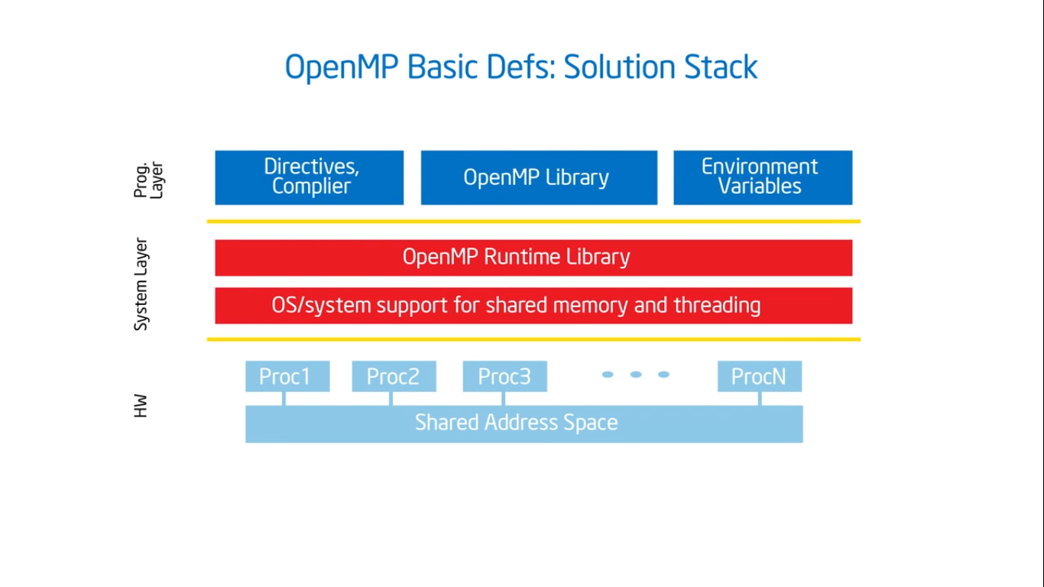

Slide 11
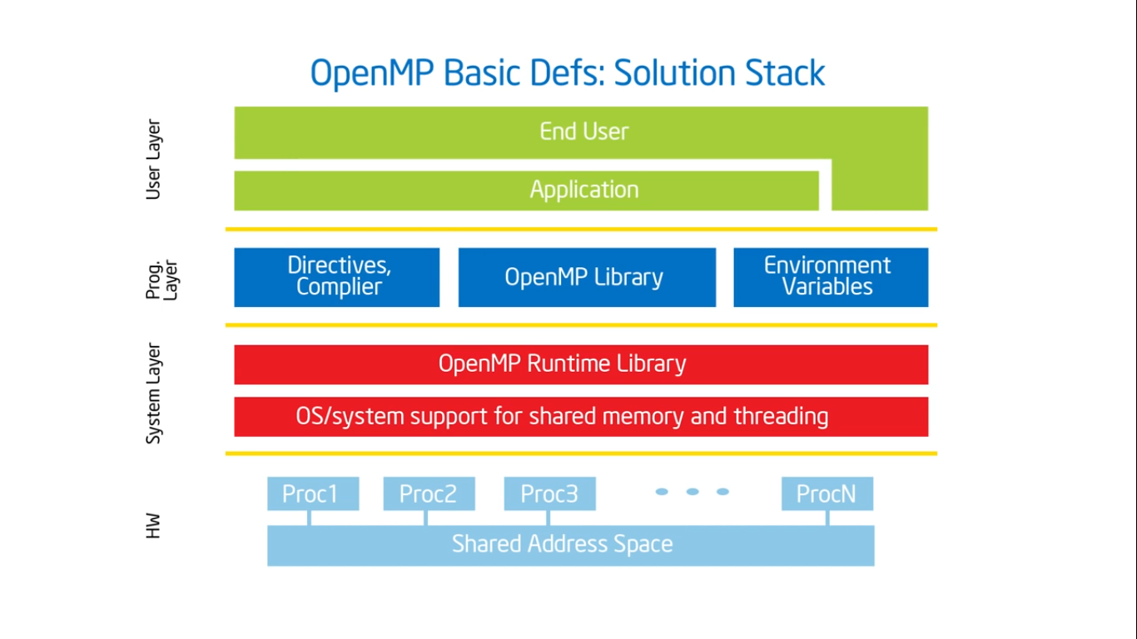

Slide 12
Compiler Notes
Linux and MAC with gcc:
gcc - fopenmp <program name> -o <executable>
export OMP_NUM_THREADS=4
./<executable-name>
Linux and MAC with PGI:
pgcc – mp <program name> –o <executable>
export OMP_NUM_THREADS=4
./<executable-name>
Linux with Intel Compiler:
icc - qopenmp <program name> -o output_file <executable>
export OMP_NUM_THREADS=4
./<executable-name>

Slide 13
Why choose OpenMP ?
Portable
standardized for shared memory architectures
Simple and Quick
Relatively easy to do parallelization for small parts of an application at a time
incremental parallelization
supports both fine grained and coarse grained parallelism
Compact API
simple and limited set of directives

Slide 14
When to use OpenMP ?
Target platform is multicore or multiprocessor.
Application is cross-platform
Parallelizable loop
Last-minute optimization

Slide 15
OpenMP Core Syntax
Most of the constructs in OpenMP are compiler directives.
#pragma omp construct [clause [clause]…]
Ex. #pragma omp parallel num_threads(4)
Function prototypes and types in the file: #include < omp.h >
Most OpenMP constructs apply to a “structured block”.
Structured block: a block of one or more statements with one point of entry at the top and one point of exit at the bottom.

Slide 16
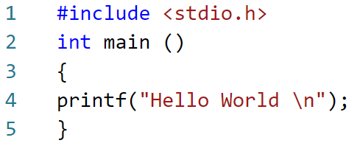
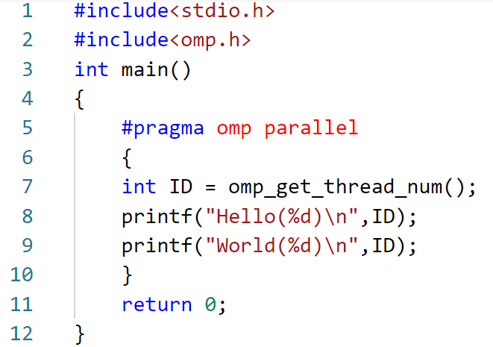
Parallel Program
Serial Program

Slide 17
Shared Memory

Slide 18
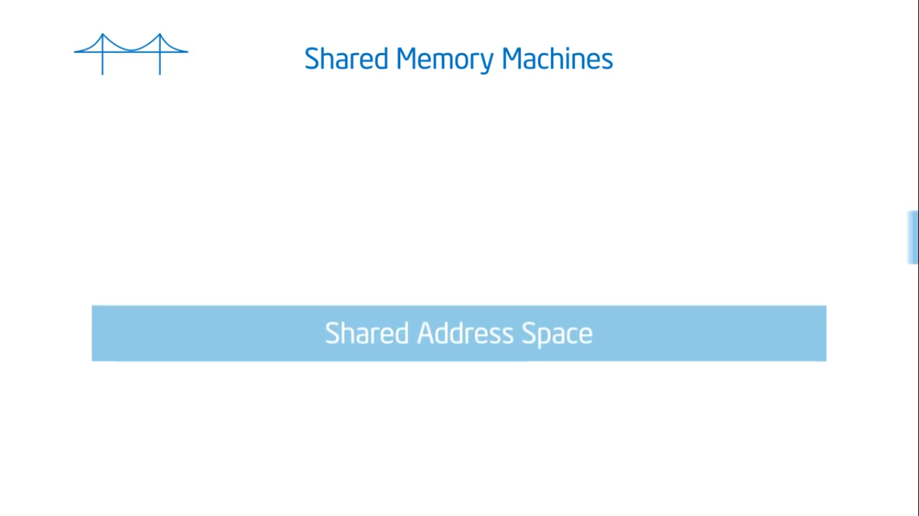

Slide 19
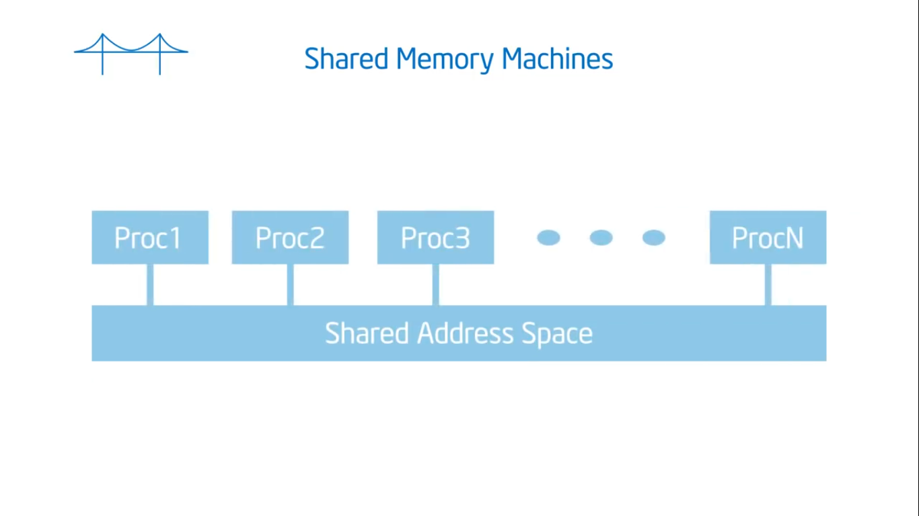

Slide 20
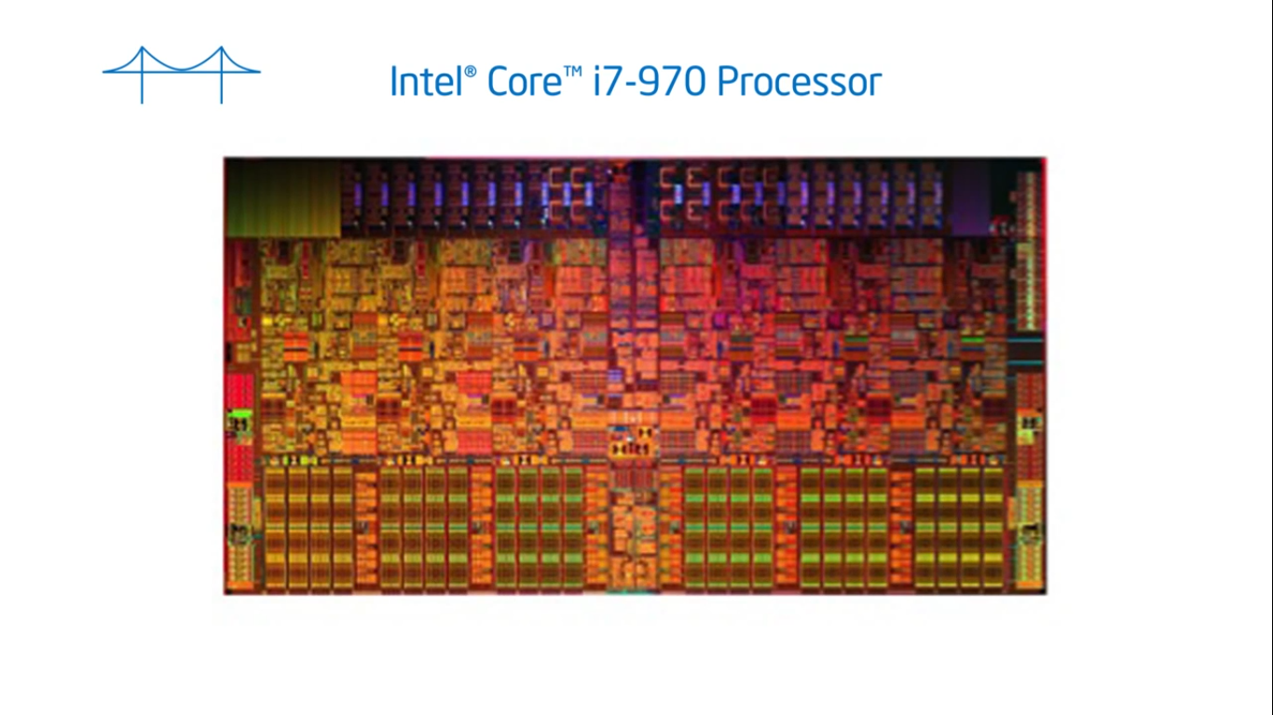

Slide 21
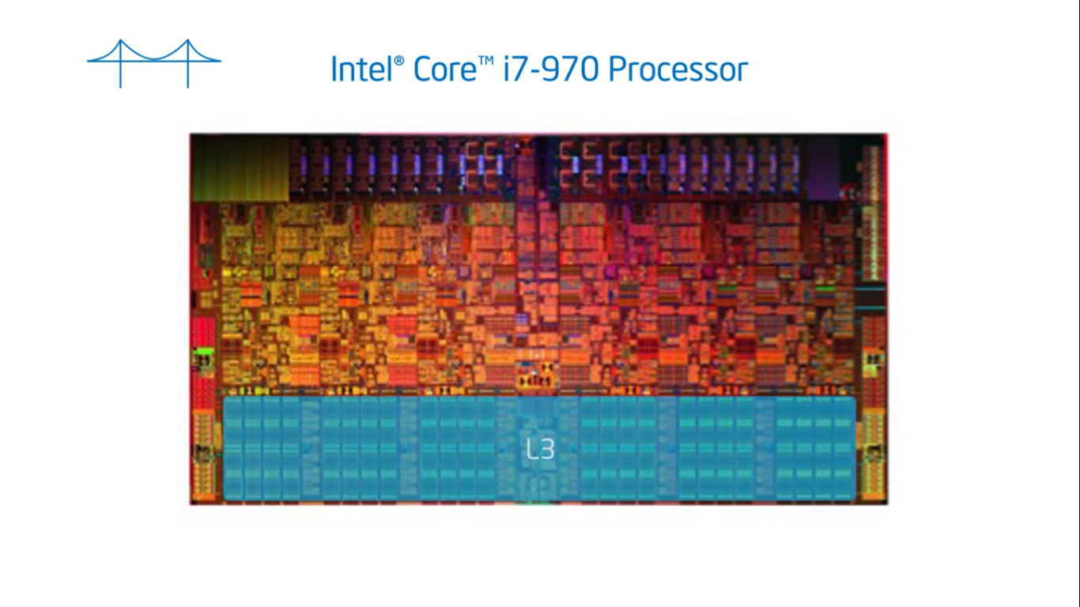

Slide 22
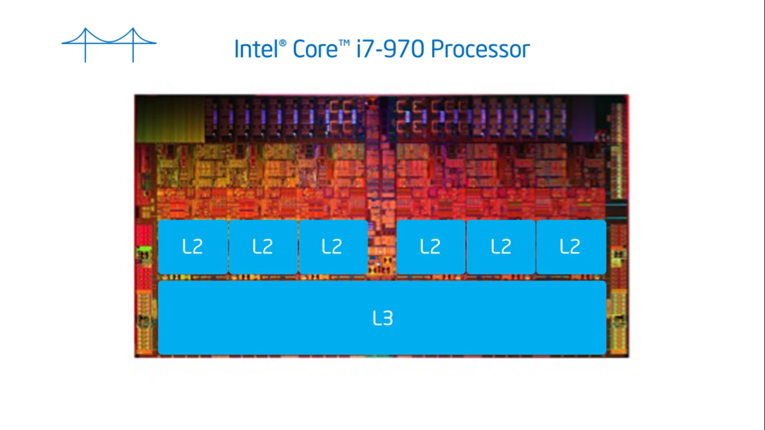

Slide 23
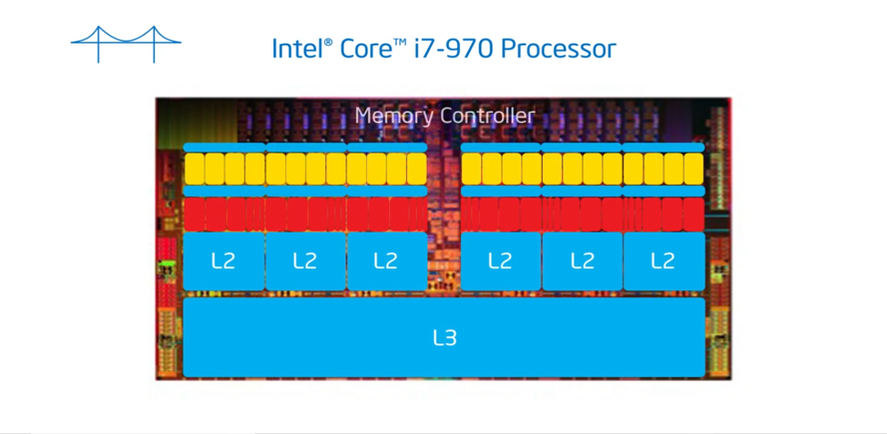

Slide 24
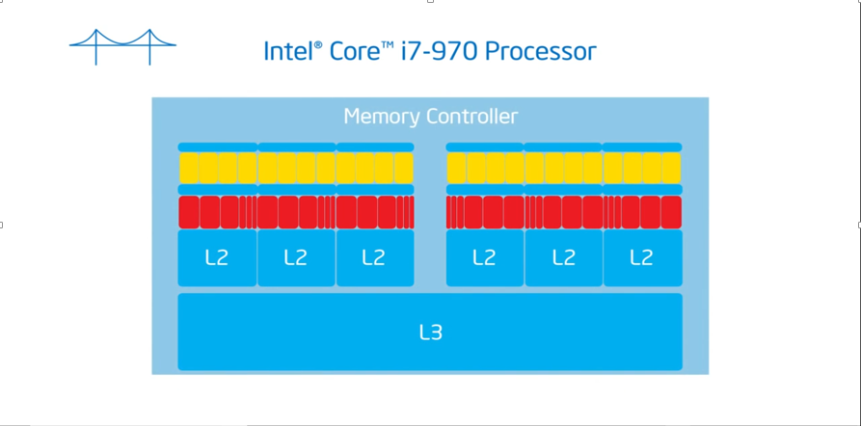

Slide 25
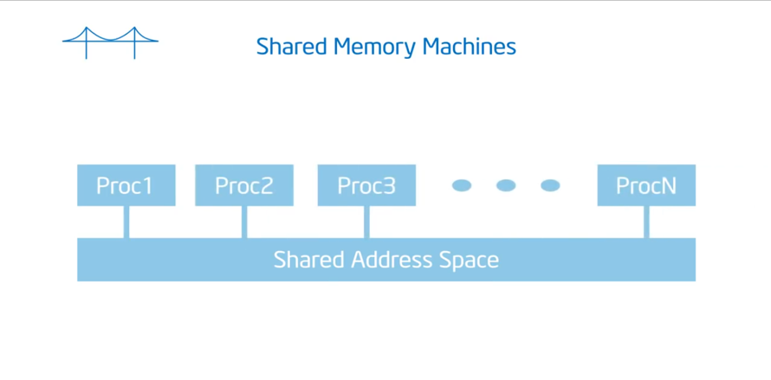

Slide 26
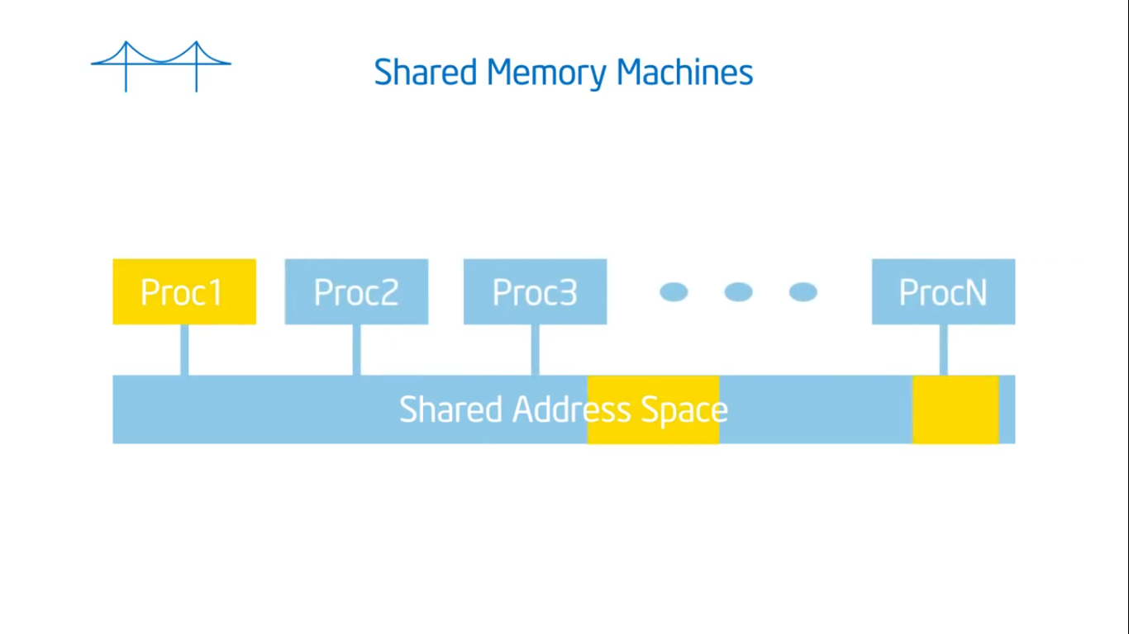

Slide 27
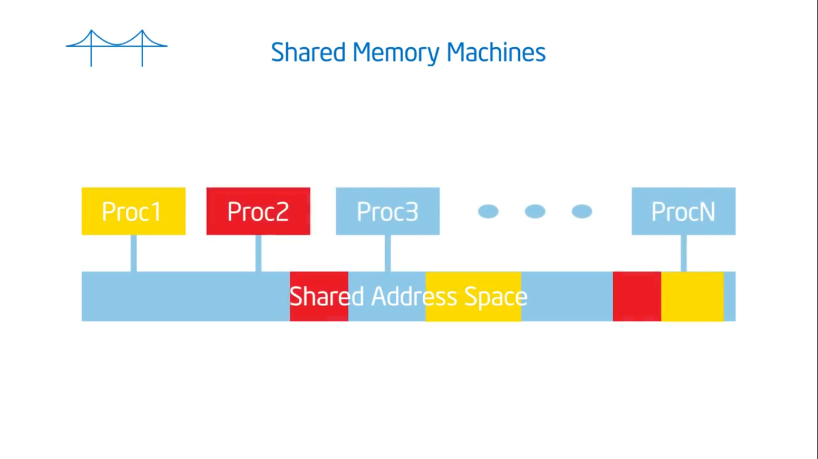

Slide 28
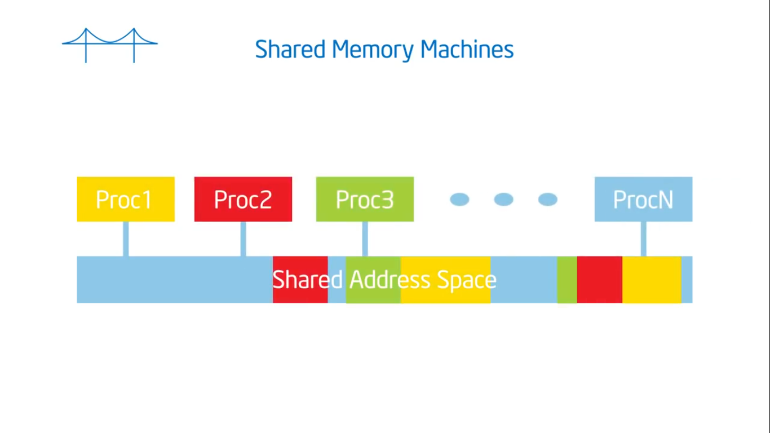

Slide 29
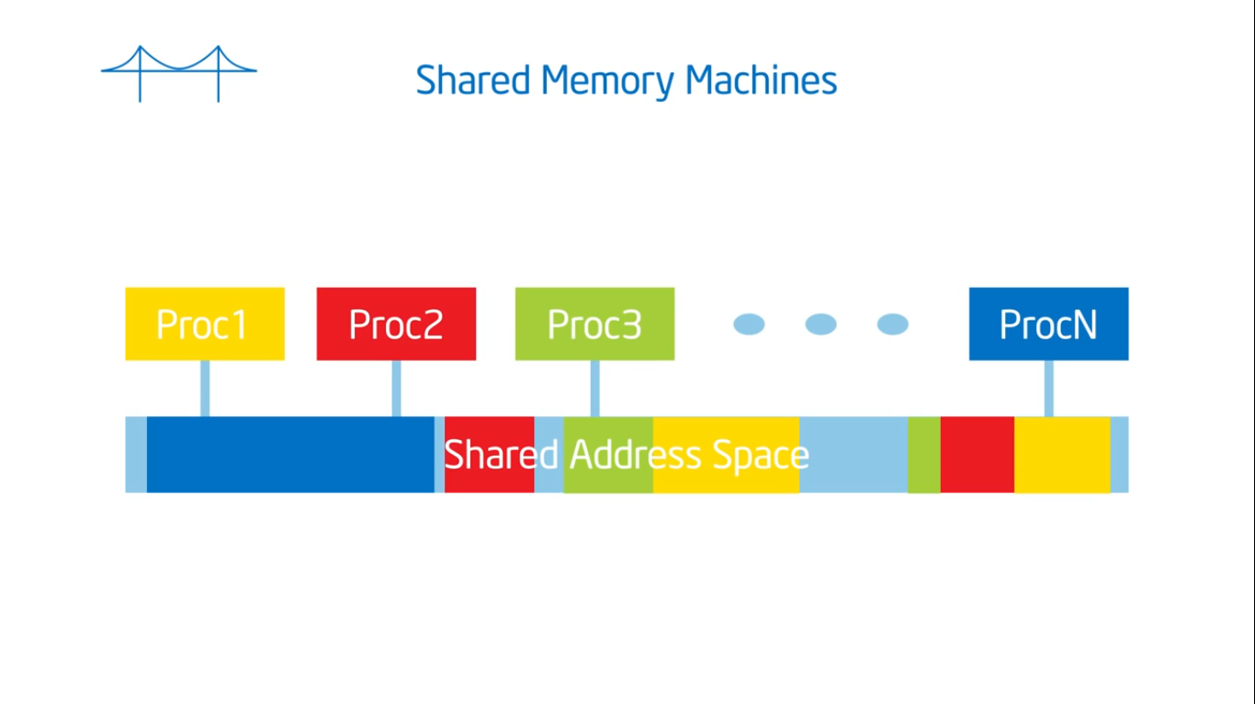

Slide 30
How do threads interact?
OpenMP is a multi- threading, shared address model.
– Threads communicate by sharing variables.

Slide 31
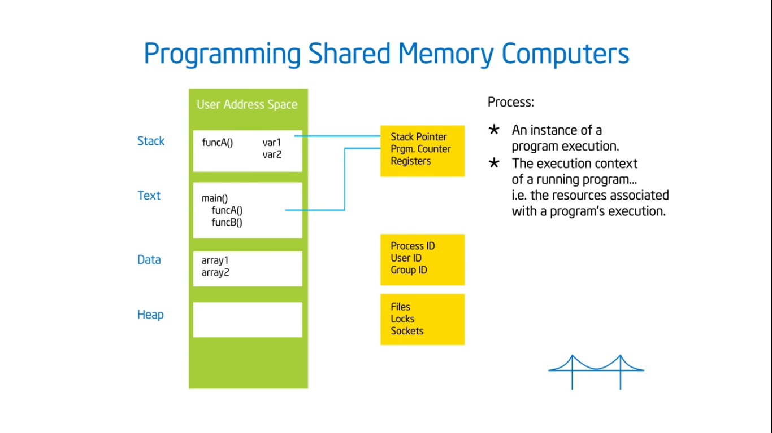

Slide 32
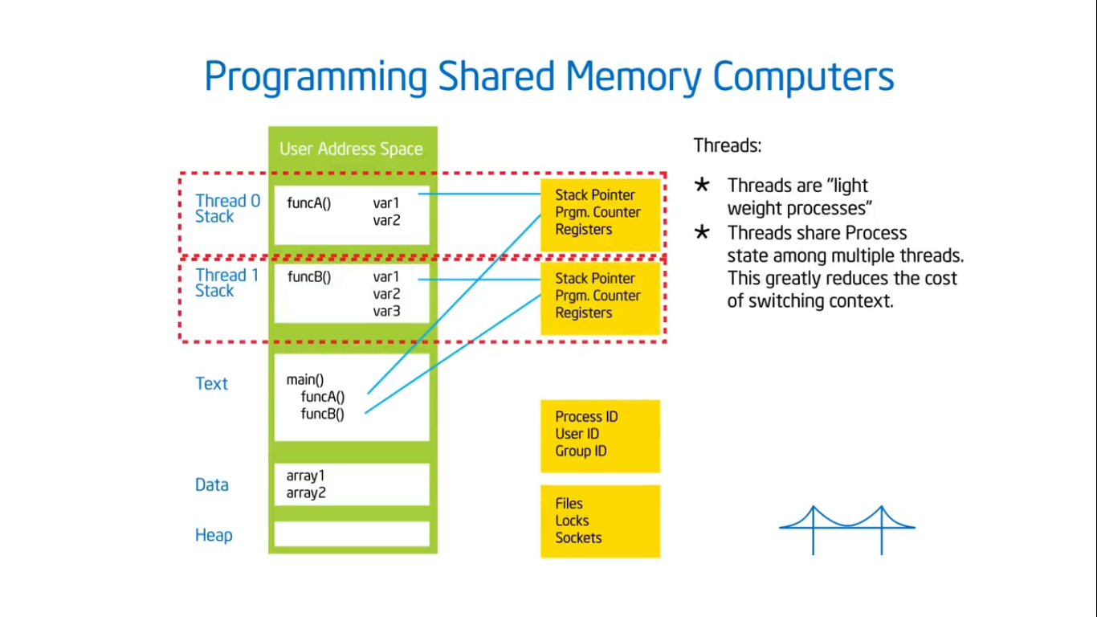

Slide 33
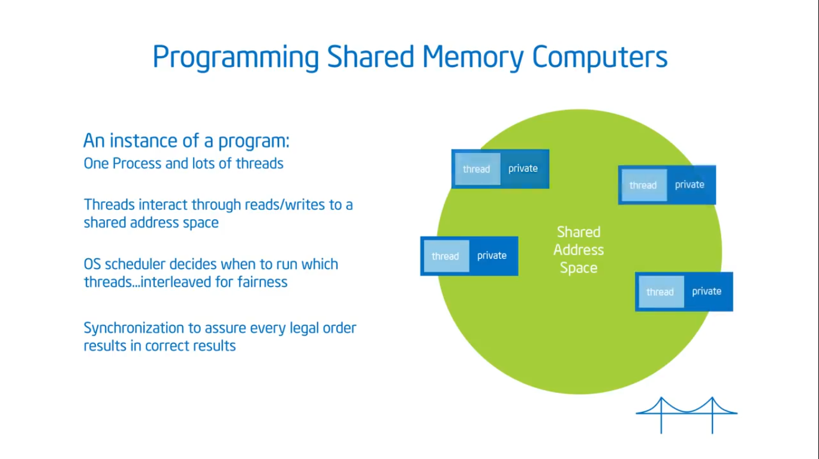

Slide 34
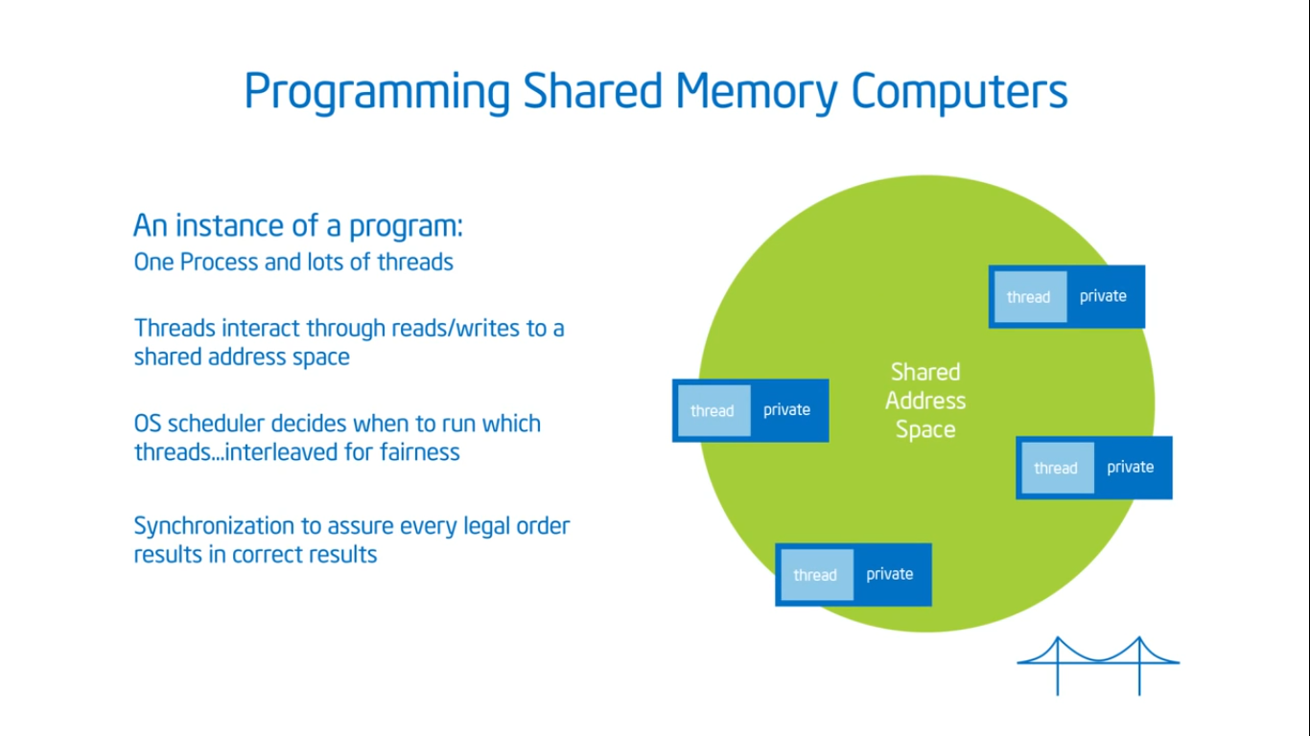

Slide 35
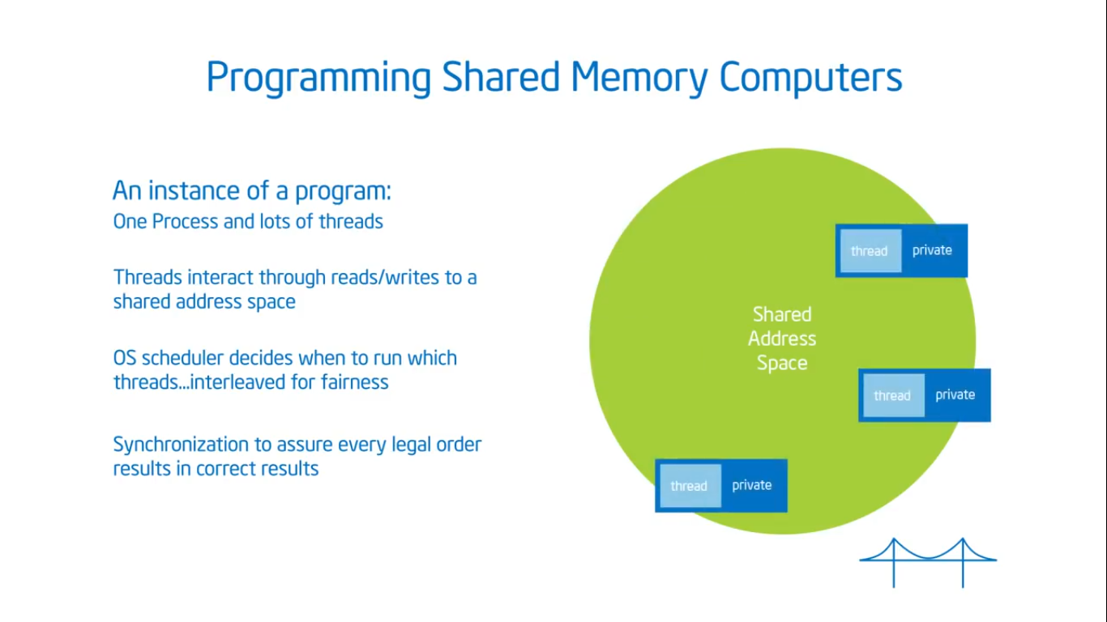

Slide 36
$ gcc -fopenmp hello.c -o hello
$ export OMP_NUM_THREADS=4
$ ./hello
Hello(0)
World(0)
Hello(1)
World(1)
Hello(2)
World(2)
Hello(3)
World(3)

Slide 37
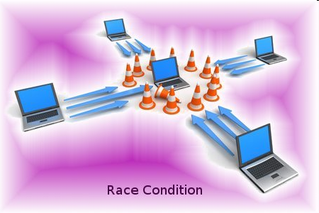
Race Condition

Slide 38
Unintended sharing of data causes race conditions:
Race condition:
When the program’s outcome changes as the threads are scheduled differently.
To control race conditions:
Use synchronization to protect data conflicts.
Synchronization is expensive:
Change how data is accessed to minimize the need for synchronization.

Slide 39


Slide 40
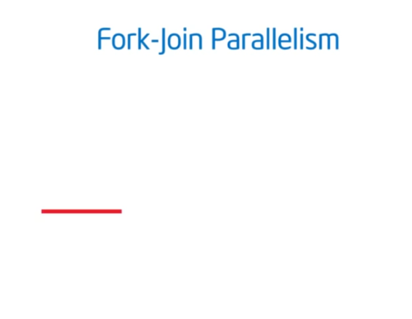

Slide 41
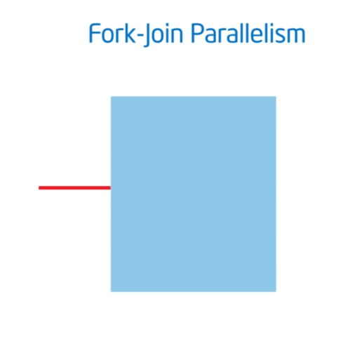

Slide 42
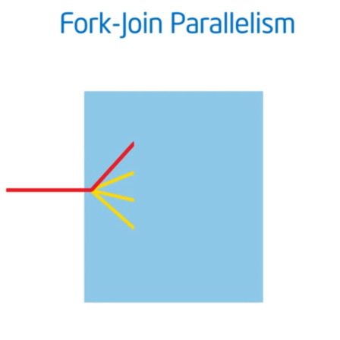

Slide 43
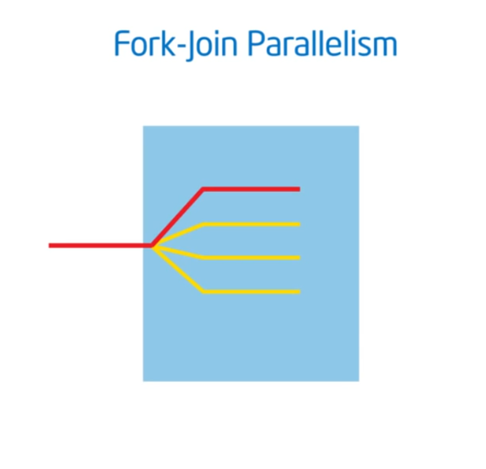

Slide 44
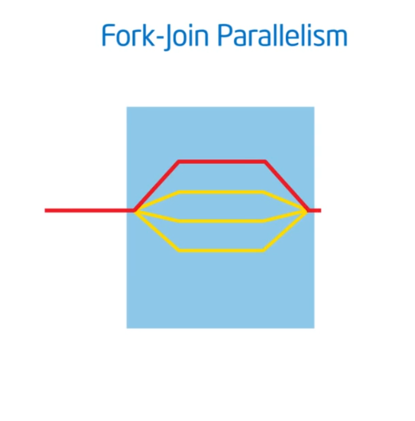

Slide 45
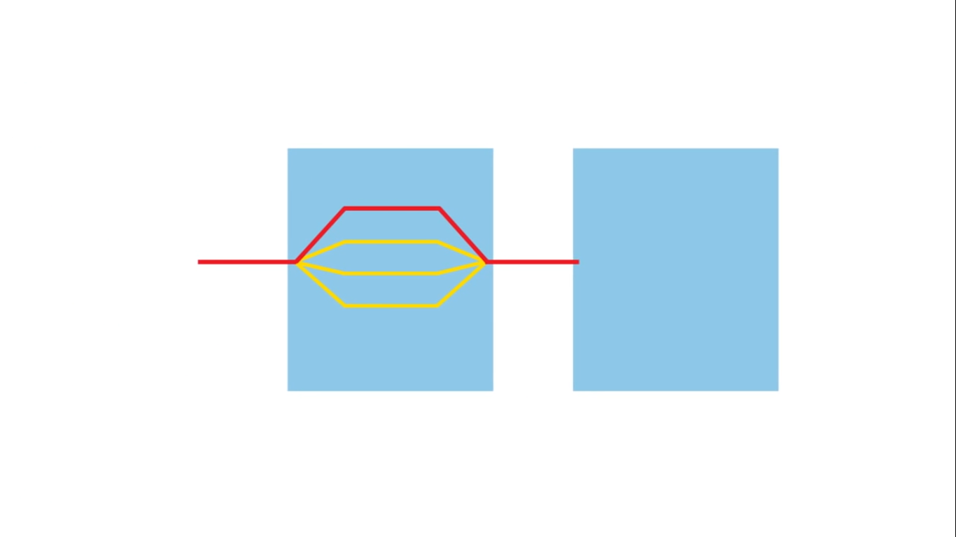

Slide 46
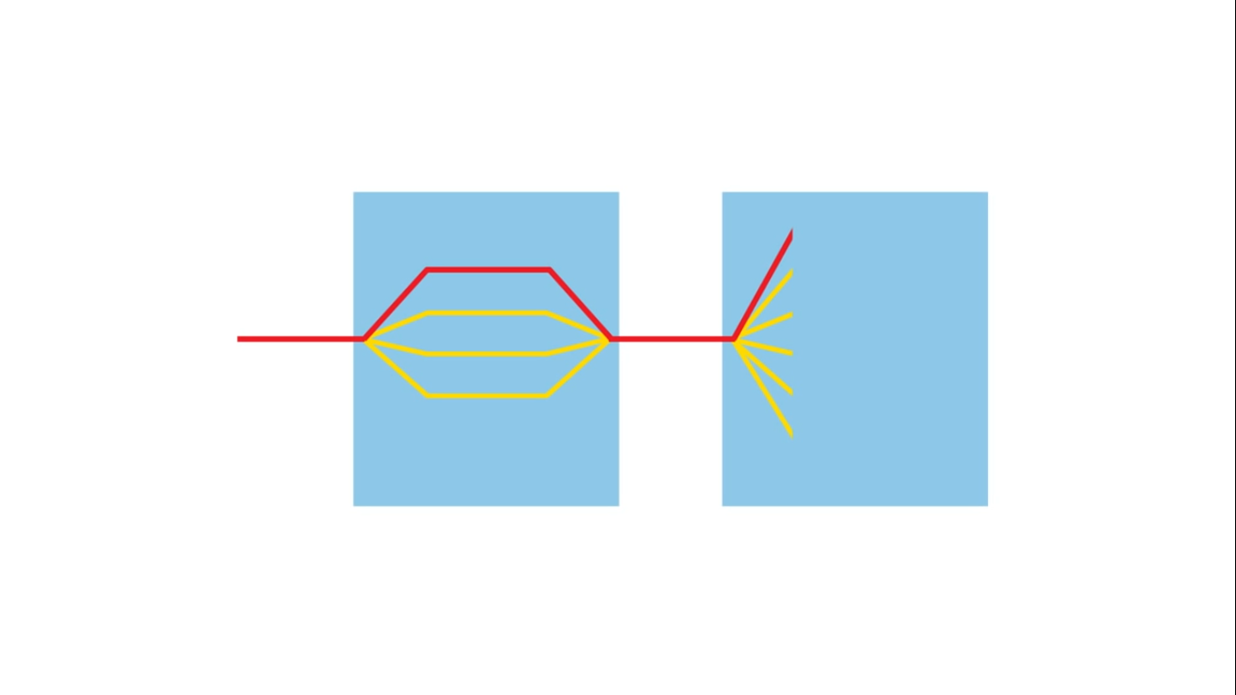

Slide 47
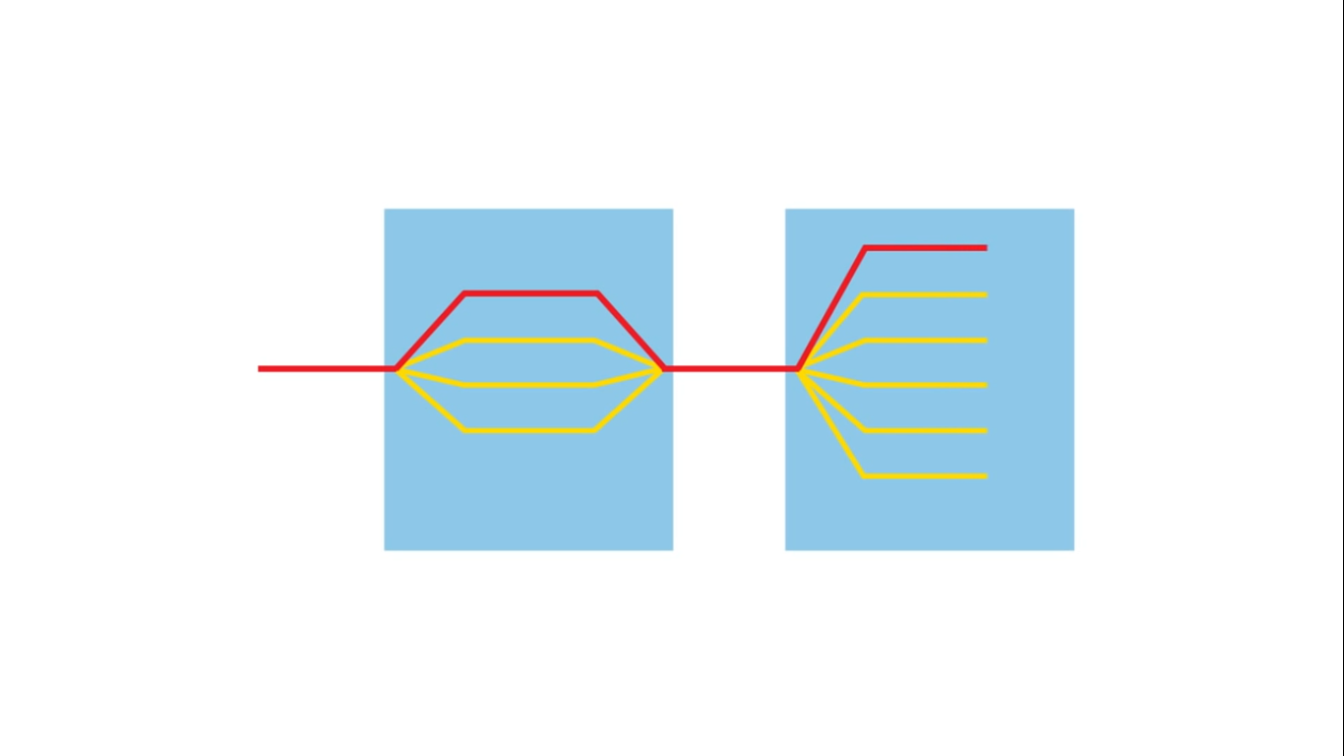

Slide 48
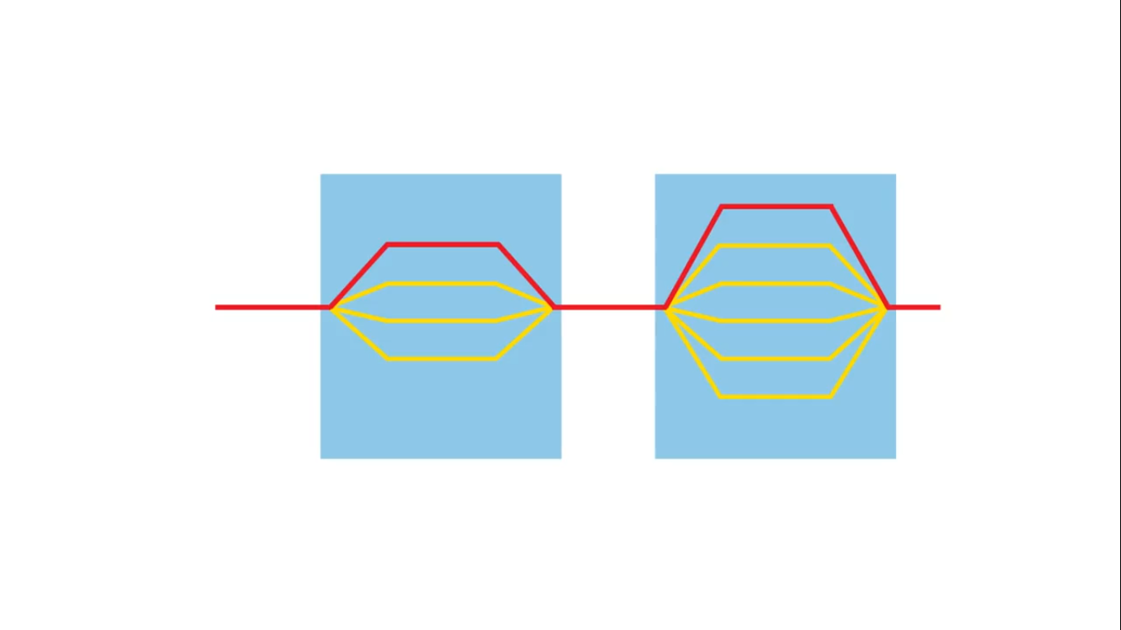

Slide 49
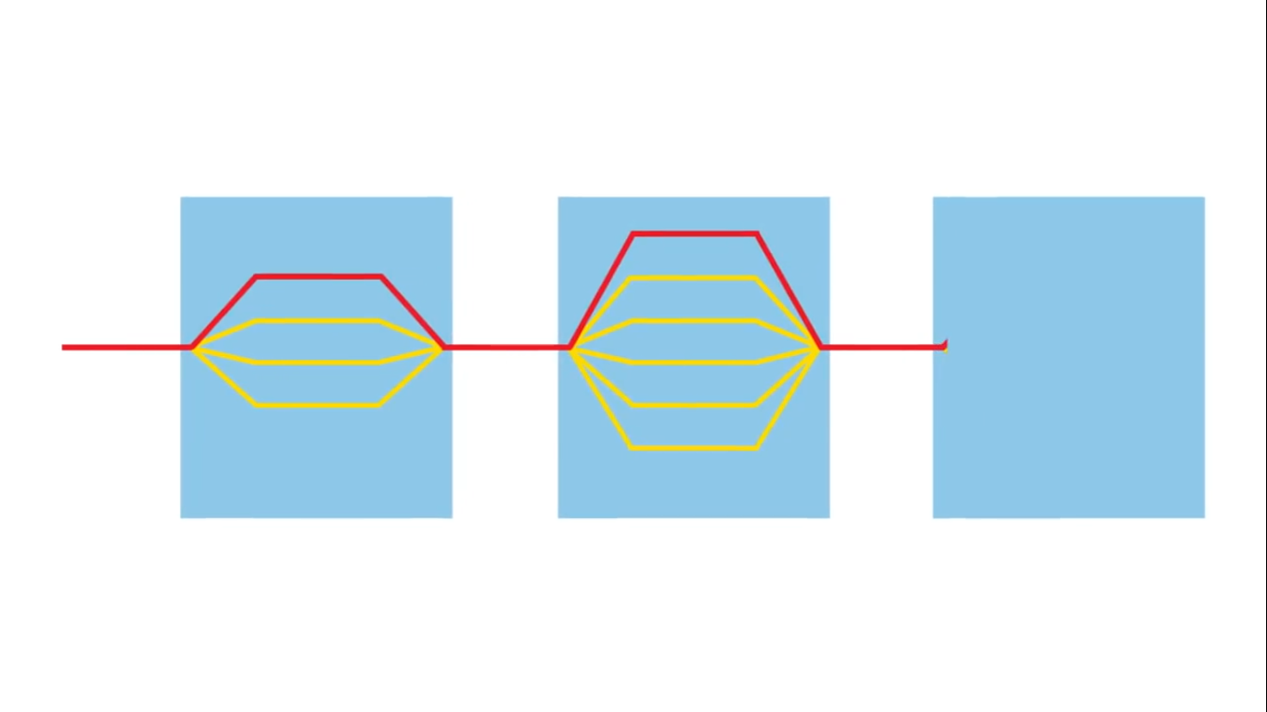

Slide 50
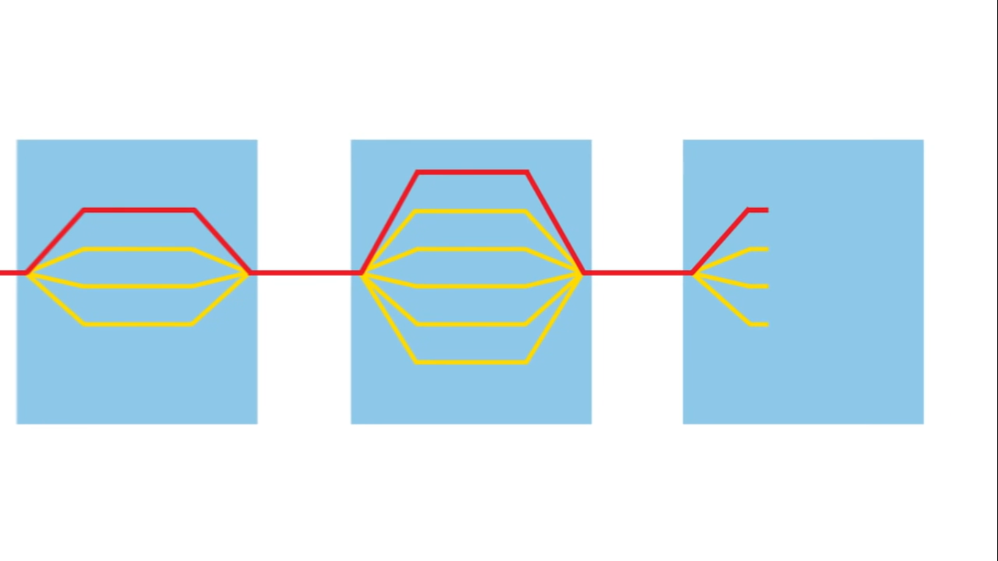

Slide 51
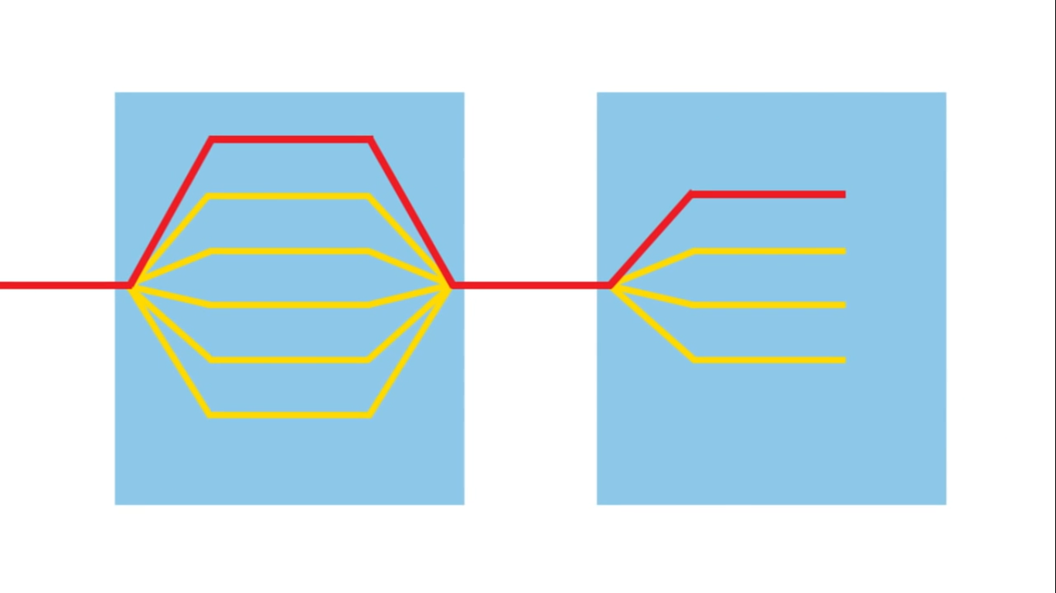

Slide 52
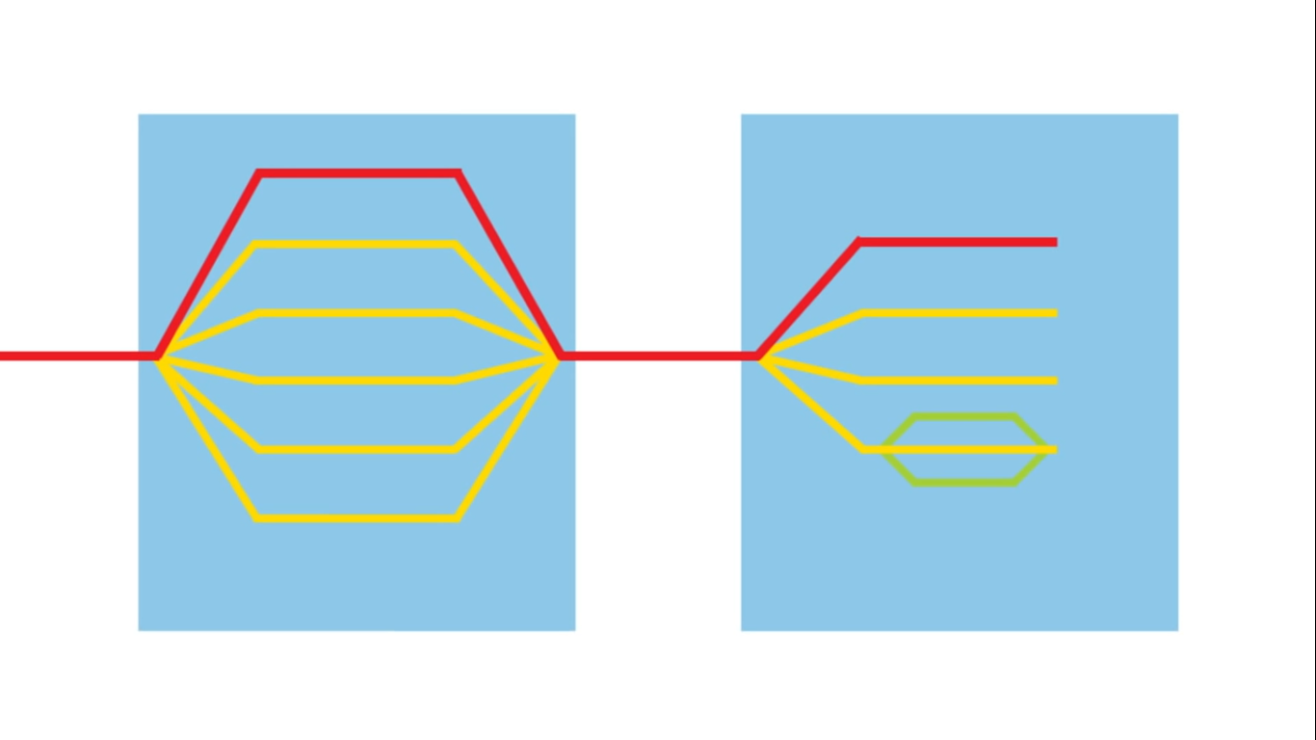

Slide 53
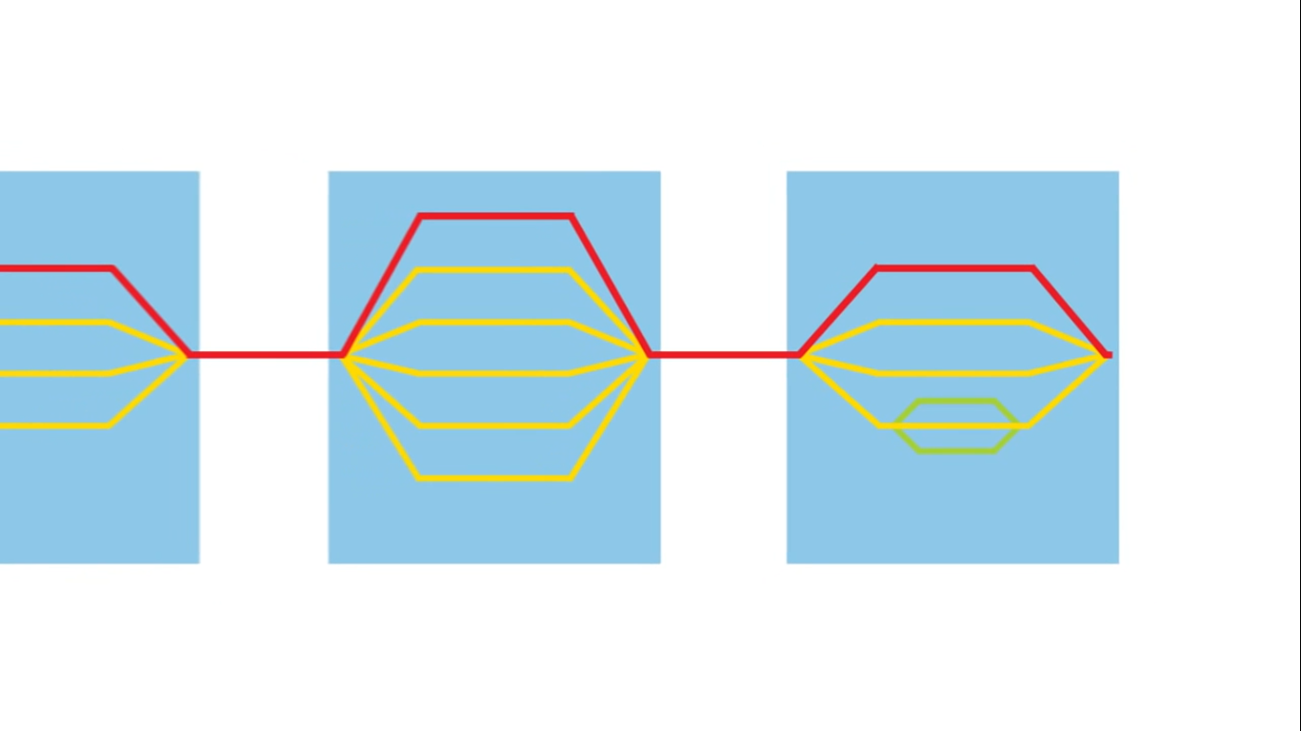

Slide 54
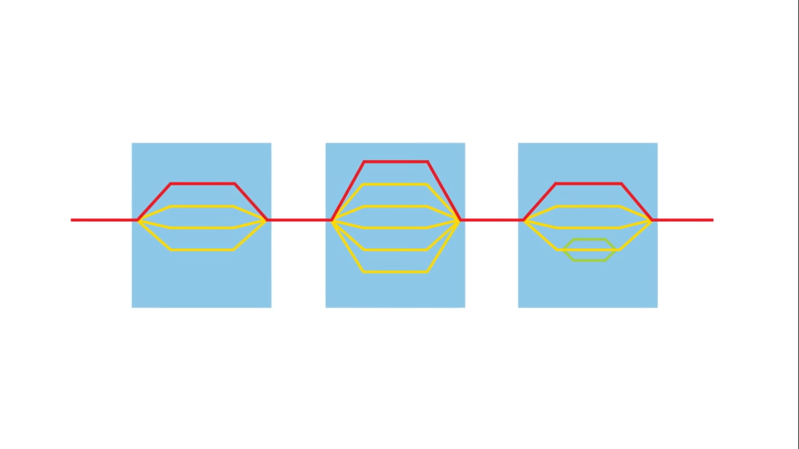

Slide 55


Slide 56
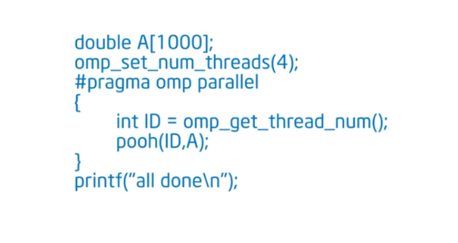

Slide 57
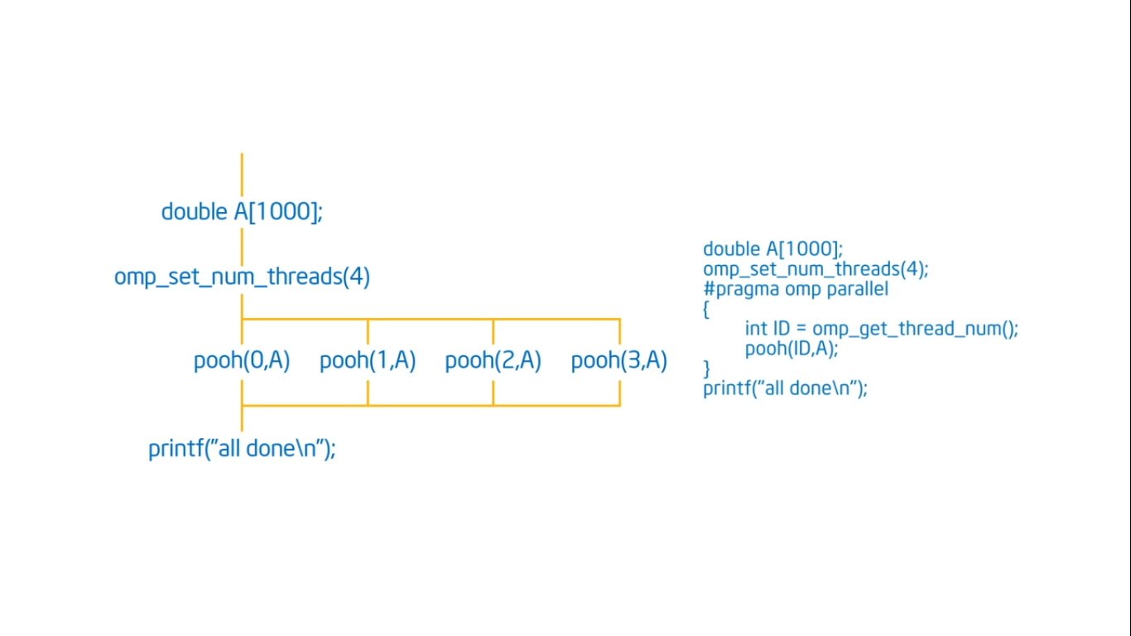

Slide 58
How OpenMP Interacts with Lower Level Runtime ?

Slide 59
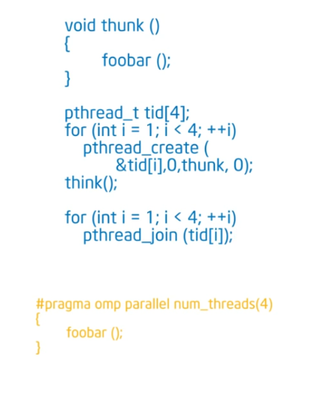
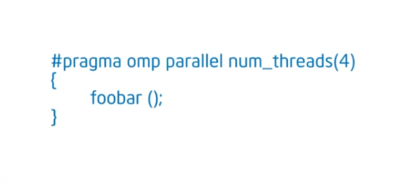

Slide 60
Pi Program

Slide 61
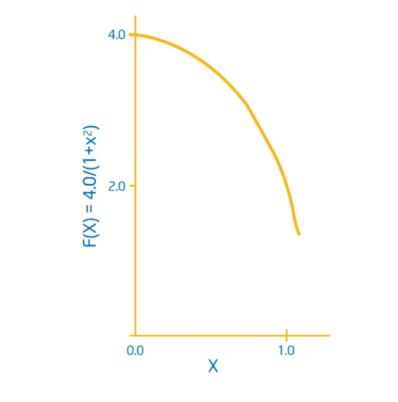
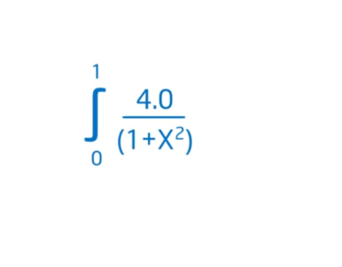
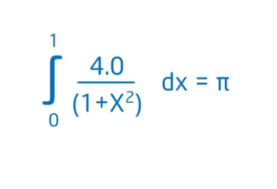

Slide 62
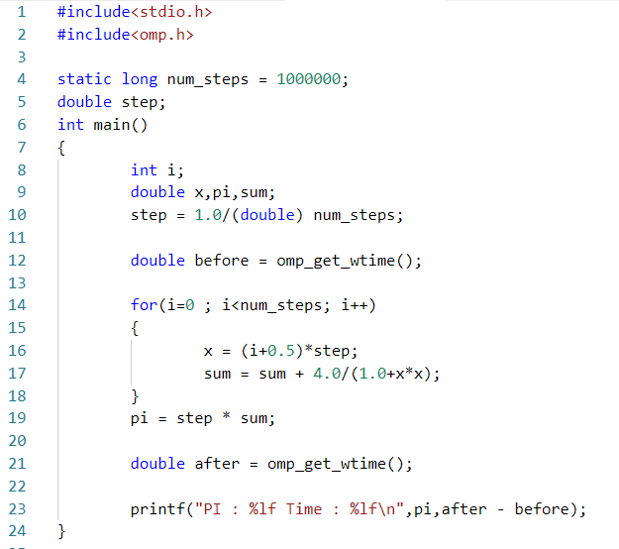
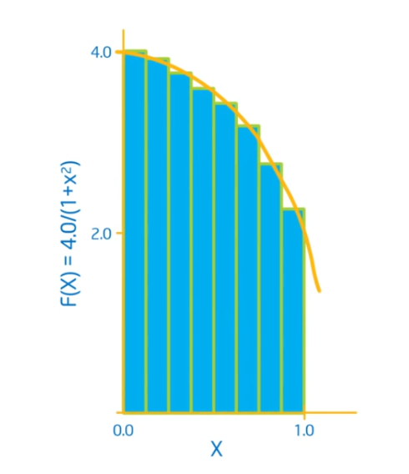

Slide 63
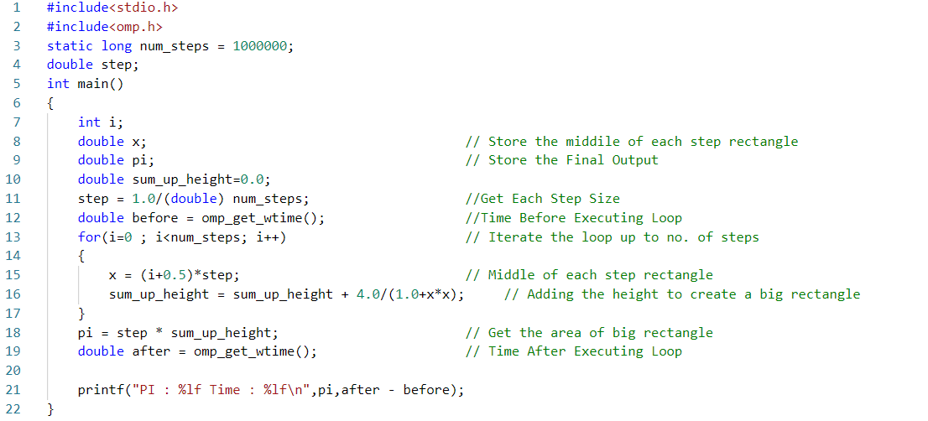

Slide 64
In addition to a parallel construct, you will need the runtime library routines
int omp_get_num_threads();
Number of threads in a team;
intomp_get_thread_num();
Thread ID and Rank
double omp_get_wtime();
Time in Seconds since a fixed point in the past.

Slide 65
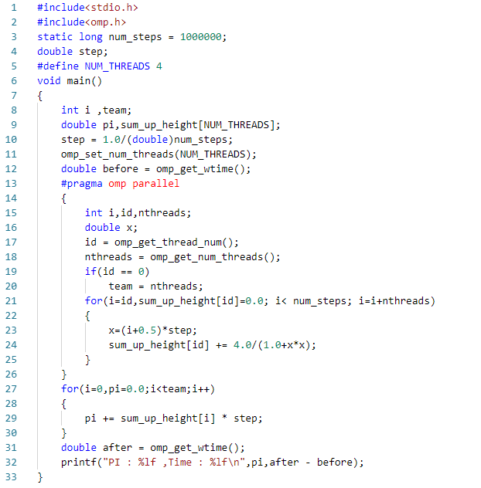
Serial Execution Time : ?
Thread Time
1 ?
2 ?
3 ?
4 ?

Slide 66


Slide 67

Thread Time
1 ?
2 ?
3 ?
4 ?

Slide 68
Do we really need to pad our arrays?
• Padding arrays requires deep knowledge of the cache architecture.
Move to a machine with different sized .
Cache lines and your software performance falls apart.
• There has got to be a better way to deal with false sharing.

Slide 69
Synchronization
Bringing one or more threads to a well defined and
known point in their execution.

Slide 70
High level synchronization:
critical
atomic
barrier
ordered
Low level synchronization
flush
locks (both simple and nested)

Slide 71


Slide 72



Slide 73


Slide 74

Critical

Slide 75

Thread Time
1 ?
2 ?
3 ?
4 ?

Slide 76


Slide 77

Thread Time
1 ?
2 ?
3 ?
4 ?

Slide 78
Work Sharing
Loop Construct
Section Construct
Single Construct
Task Construct

Slide 79

Loop Construct

Slide 80


Slide 81


Slide 82
When To Use The Schedule Clause

Slide 83
Static
Predetermined and predictable by Programmer.
Least work at runtime.
Scheduling done at compile time.
Dynamic
Unpredictable, highly variable work per iteration.
Most work at Runtime.
Complex scheduling logic at runtime.

Slide 84

Runtime

Slide 85



Slide 86


Slide 87


Slide 88



Slide 89



Slide 90


Slide 91

Serial Code
Parallel with Reduction Clause

Slide 92

Private & Shared Clause
#pragma omp parallel for private(i), firstprivate(b), lastprivate(a)
Barrier (Explicit / Implicit)

Slide 93


Single Clause
Barrier (Explicit / Implicit)

Slide 94

Master Clause
Barrier (Explicit / Implicit)

Slide 95


Sections

Slide 96

Some other clauses ……

Slide 97




Slide 98


Slide 99

OpenMp
Constructs

Slide 100


Runtime Library Routines

Slide 101




Slide 102

Environment Variables

Slide 103


Slide 104


Slide 105



Slide 106

Lock Routines

Slide 107
Good Things about OpenMP
Incrementally Parallelization of sequential code.
Leave thread management to compiler.
Directly supported by compiler.

Slide 108
Limitation
Requires compiler which supports OpenMP
Internal details are hidden
Run efficiently in shared-memory multiprocessor platforms only but not on distributed memory
Limited performance by memory architecture

Slide 109
References
https://computing.llnl.gov/tutorials/openMP/
http://wiki.scinethpc.ca/wiki/images/9/9b/Ds-openmp.pdf
www.openmp.org/
http://openmp.org/sc13/OpenMP4.0_Intro_YonghongYan_SC13.pdf

Slide 110
Thank You

